Slide 1

Trending YouTube Categories By Country
Ryan Namasaka, Rose Militante and Jesus Zamora

Slide 2
Introduction Analysis Goals Observations

Slide 3

Reviewed data on YouTube trending videos from 6 different countries
- US, Canada, Mexico, Japan, India, South Korea
Notes:
Rose:
At its core, our focus was on Categories of YouTube trending videos
We wanted to see if the category that trended the most in US was the same for other countries regardless of publishing day and how engaged their viewers were.
Used data from Kaggle. com
“To determine the top-trending videos, YouTube uses a combination of factors including measuring users interactions (number of views, shares, comments and likes). Note that they’re not the most-viewed videos overall for the period of time”.
Had many columns that we decided only to focus in on what we found useful. Easy to get carried away.
Video Id, Trending Date, Publish Date, Title, Channel Title, Category ID, Publish Time, Tags, Views, Likes
Scaled Down - Originally 10 countries available. –Narrowed down to 3 from North America and 3 from Asia
214, 723 rows of data
Challenges
Video Titles and Tags were not in English
Category IDs were only numerical values, so we needed to pull in the JSON files to identify what the categories were.
In reviewing the Trending date – many video ids would trend on several dates and in several countries
Utilized Timedate library to manipulate the Publish Date

Slide 4
Identify top trending categories by country? Is what’s popular in the US, the same in other countries?
Do top trending categories vary over time?
Are there categories that illicit more ‘likes’, ‘dislikes’ and comments over others?
Notes:
Rose:
These are the questions that we were looking to answer based on the data that we selected.
Talk about how we divided the work.

Slide 5
Identify top trending categories by country? Is what’s popular in the US, the same in other countries?
Notes:
Jesus
- re-introduce this question and slides 6 - 8

Slide 6
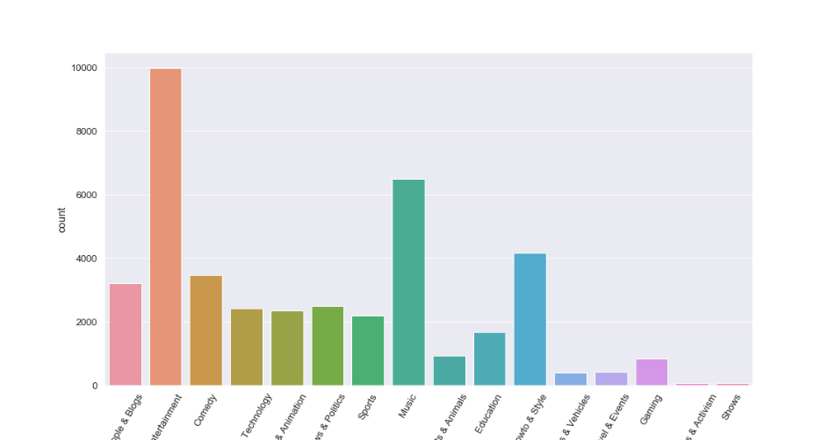
US Top Trending Categories
Notes:
Jesus:
Entertainment category leads in the United States as the most trending category followed by music ,while the least trending categories are ‘Nonprofits and Activism’ and ‘Shows’.
One of the struggles Ryan had was in formatting the x-axis x-ticks so that the PNG didn’t cut it out.
Ryan also utilized a library called Seaborn (similar to Matplotlib) to produce these colorful charts.

Slide 7
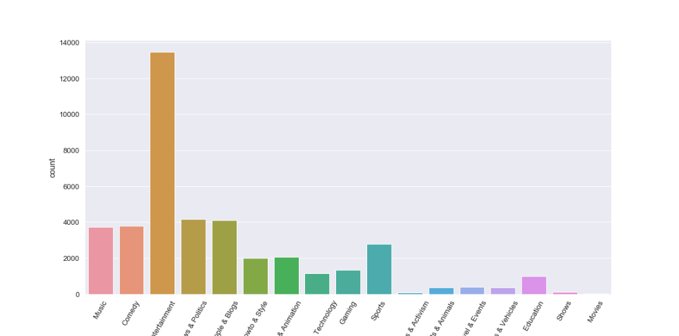
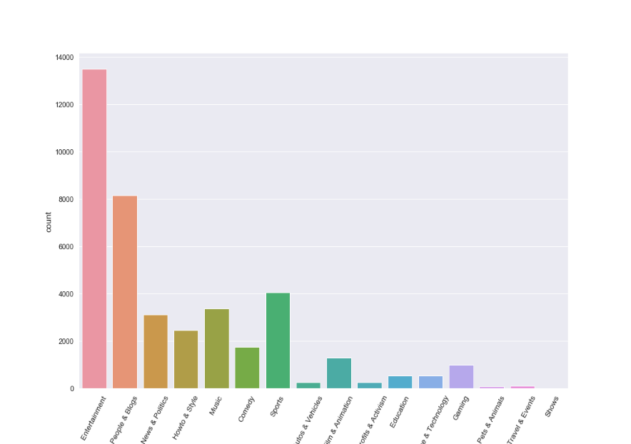
Canada
Mexico
Notes:
Jesus:
In the North American countries Entertainment categories happens to be the most trending while the least trending category happens to vary from country to country.
Let’s see if this is consistent with the Asian countries….
To add, in our excel files, the category’s were identified by category id’s. Luckily, Kaggle put out JSON files that Ryan pulled in to translate the category IDs to their corresponding Category descriptions.

Slide 8
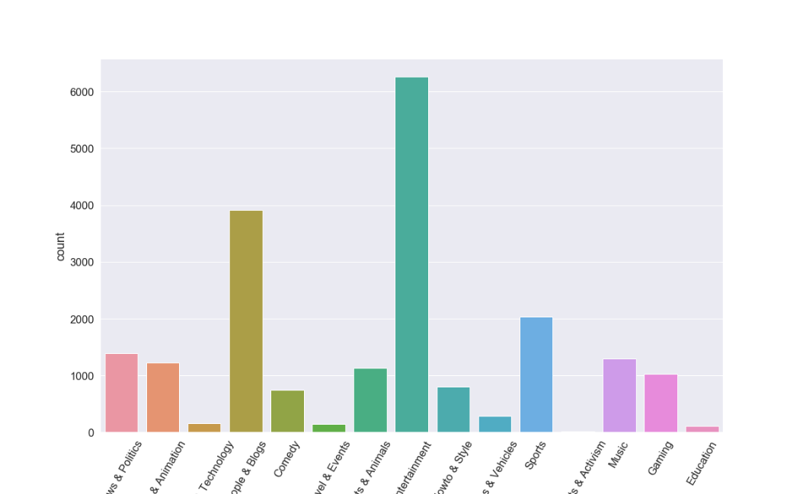
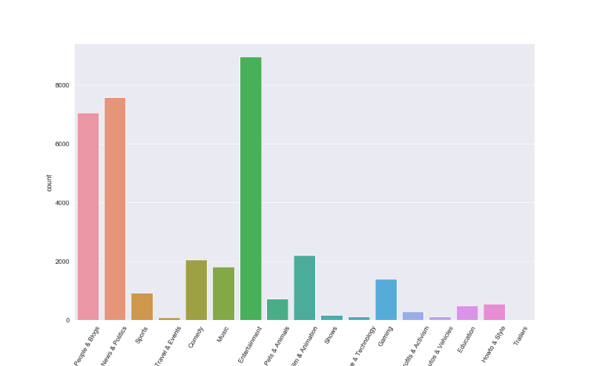
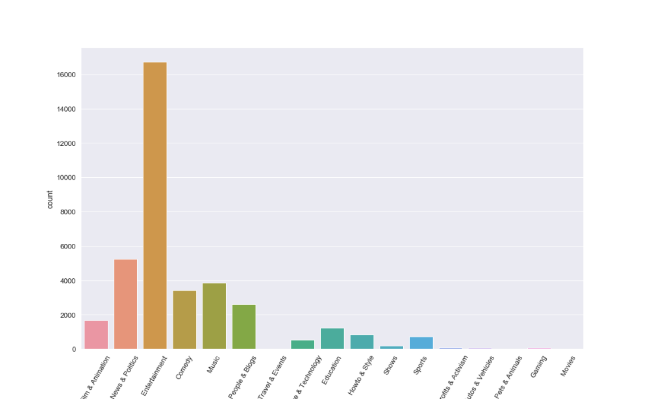
Japan
South Korea
India
Notes:
Jesus:
Entertainment Category is also the top trending category in the 3 Asian countries we selected.
In all the six countries it is evident that the entertainment category is the top trending category.
While the least trending category does vary from country to country.
- For example: Japan - the least trending category does differ from that in Mexico and the one in the United States.

Slide 9
Do top trending categories vary over time?
Notes:
Rose
Data is based off of the Publishing Time.
Utilized Timedate library to manipulate the Publish Date
It was in a string, YYYY/DD/MM format and we needed a function from Timedate to be able to convert this to which day of the week that date landed on.

Slide 10
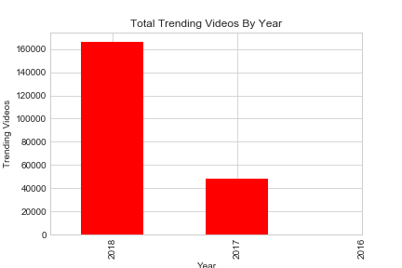
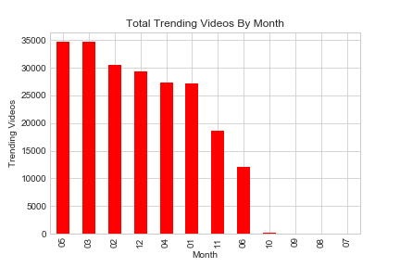
The data only consisted of videos that were published during an 8-month period.
(November of 2017 through June 2018)
Notes:
Rose
In reviewing the data:
The data spanned between 2017 – 2018.
We didn’t have a complete years’ worth of data.
The data consisted of videos that were published during an 8 month period. (between November of 2017 through June 2018).
This made it challenging to determine category changes from a seasonal perspective.
This led us to zoom in our timeframe to a ‘by day of the week’ window that resulted in a more useful study.

Slide 11
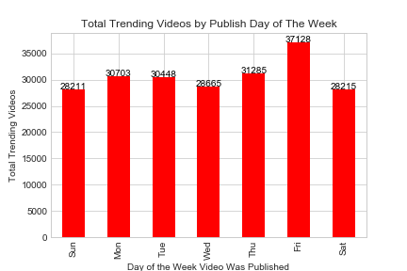
Notes:
Rose
More trending videos are published on Friday versus other days of the week with the lowest being published on Saturdays and Sundays.

Slide 12
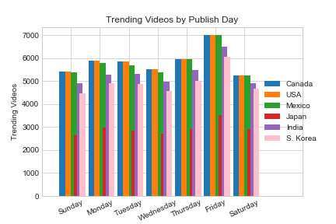
Notes:
Rose
When examining all 6 countries’ separately, Friday still trended similarly with the most trending videos published on that day.

Slide 13
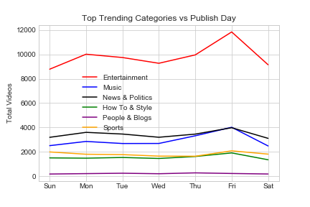
Notes:
Rose
In reviewing the top 6 trending categories by publish day, it was difficult to truly see what was happening on each day when you plotted all 6 categories on the same chart.
The entertainment category’s volumes were much greater than the other categories causing the other categories to appear flat.

Slide 14
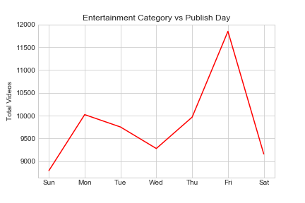
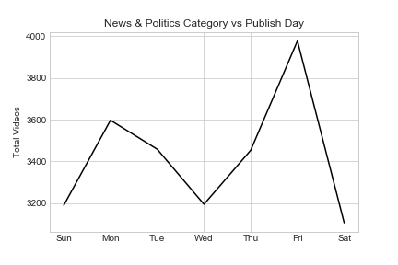
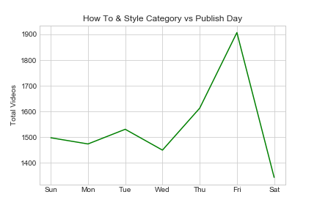
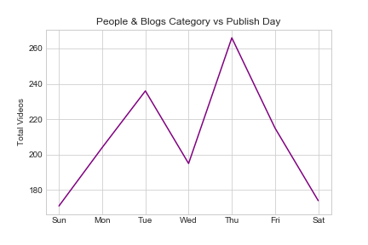
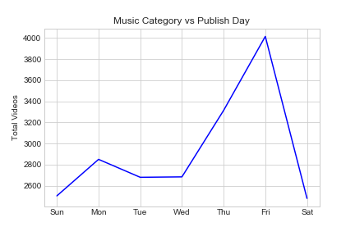
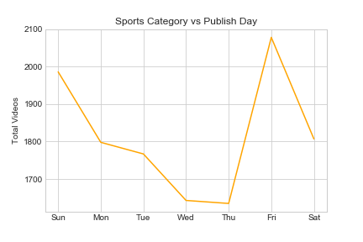
Notes:
Rose
When each category was plotted individually, you are able to depict each category’s trends clearly.
5 out of the 6 categories reflect videos published on Friday as having the most trending videos. However, the ‘People & Blogs’ category that had more videos that trended when published on Thursday.

Slide 15
Are there categories that illicit more ‘likes’, ‘dislikes’ and comments over others?
Notes:
Jesus
In order to get my data I pulled the relevant information that pertained to my questions, category_id, likes, dislikes, and comment count. To get my data I grouped by category ID, then sorted each column by their top values and took the top 5 up based on category_id. Each column was merged together until I had the dataframe with the info I wanted.

Slide 16
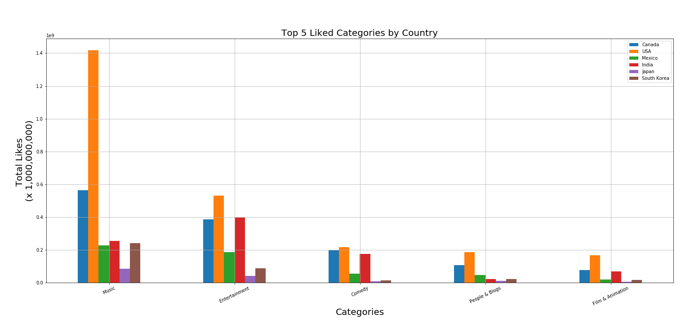
Notes:
Jesus:
Likes Analysis
Overall it seems as though the countries we chose, seem to follow the trend from the US. It’s interesting to note that music in the US has an astronomical number of likes. Top categories by country:
Canada, India -> Entertainment
USA, Mexico, Japan, South Korea -> Music
Engagement: Music and Entertainment seem to illicit the most likes which makes sense since those are the top categories. Its interesting that see that besides Canada and the US, India seems to get more likes but not nearly what you would expect from a country with 1 billion+ people.

Slide 17
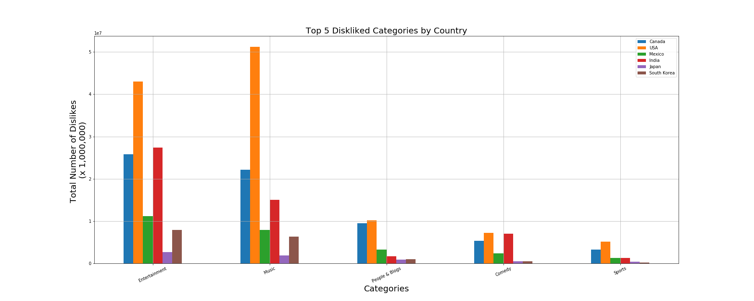
Notes:
Jesus:
Canada, Mexico, Japan, South Korea -> Entertainment
USA -> Music
Based on the categories in likes I expected Entertainment and Music to be the top categories for dislikes. Although it seems as though more countries interact with likes, that’s a bit misleading because the number of dislikes are way lower than the total number of likes. As before Canada, USA and India lead the charge with more interaction with dislikes. For dislikes its interesting to note that the last of the top five has been replaced by sports. Sports didn’t show up in likes but showed up in dislikes, so it seems as though people that are watching with sports videos are more likely to interact with the dislike button than the like button. Overall the dislike button gets way less interaction than the like button. Our top disliked category has a little over 5 million dislikes while our top like has 1.4 billion likes. I think with further analysis that would be an interesting question to answer. Why do people interact with like? Are they using it as a bookmark? Do people tend to close out videos they don’t like etc.

Slide 18
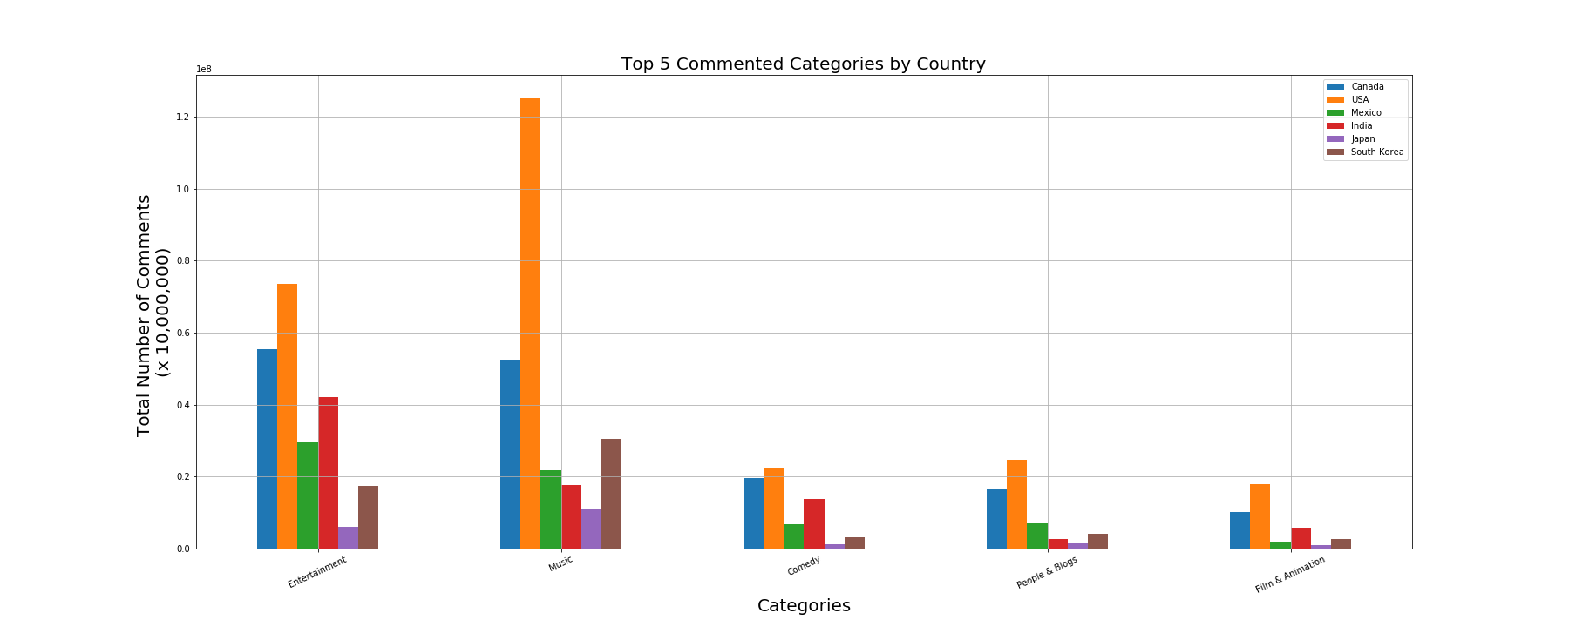
Notes:
Jesus:
Canada, Mexico-> Entertainment
USA , India, Japan, South Korea-> Music
For most commented the same categories from likes have reappeared. It’s interesting to note that music and entertainment seem to get more comments than dislikes in the categories. It seems as though people interact more with videos they like than with videos they don’t. One thing about comment count is that it does not take into account if it was a positive comment or negative. So while they are interacting with comments it doesn’t mean they like the video. Another possible question could be into looking into positive and negative comments. Are people not interacting with the dislike button but they are voicing their opinions in the comments?

Slide 19
Top Trending Category is Entertainment for these 6 countries: US, Canada, Mexico, Japan, India, South Korea
Notes:
Jesus:
In conclusion,
Entertainment was the lead category
- regardless of which country you were in, irrespective of the time the video was published, and when reviewing the amount of engagement factors such as likes, dislikes and comments.

